Slide 1
Finite Automata
Chapter-2 (Part-4)

Slide 2

NFA with ε-transitions
Another extension of the finite automaton.
The new feature allows a transition on ε, the empty string.
An NFA is allowed to make a transition spontaneously without receiving an input.

Slide 3
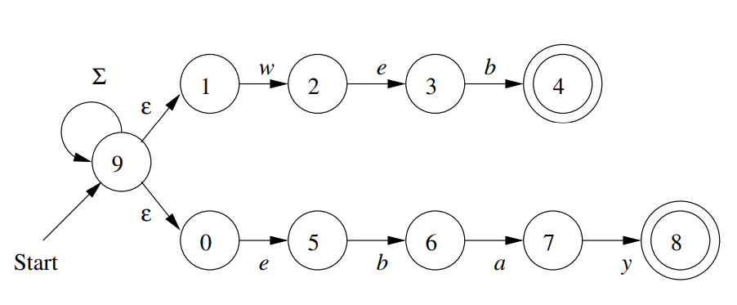
Uses of ε-transitions
Example 1: An NFA recognizing the keywords web and ebay
Using ε-transitions to help recognize keywords

Slide 4
Uses of ε-transitions
Example 2: An NFA that accepts decimal numbers consisting of:
An optional + or – sign,
A string of digits,
A decimal point, and
Another string of digits
Either this string of digits or the string (2) can be empty but at least one of the two strings must be nonempty.

Slide 5
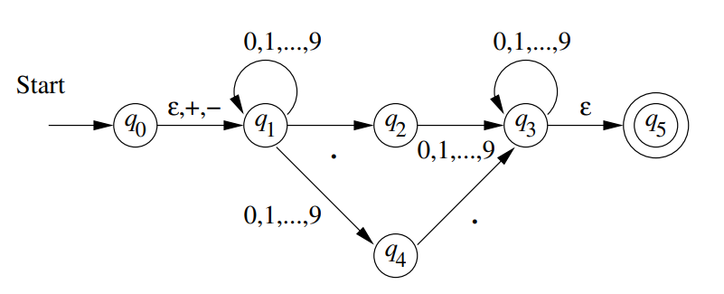
Uses of ε-transitions (cont’d)
An ε-NFA for accepting decimal number
Ʃ = {+, - , ., {0,1,2,3,4,5,6,7,8,9}}
+ sign and digits before . are optional; hence ε-transition from q₀ to q₁ (simultaneously in q₀ and q₁)
Transition from q₀ on inputs digit and . are not needed because they are defined for q₁
What path do we follow with input .2?

Slide 6
Uses of ε-transitions (cont’d)
An ε-NFA for accepting decimal number
Digits after period also optional; hence ε-transition from q₃ to accepting state
What path do we follow with input 2.?

Slide 7
Uses of ε-transitions (cont’d)
An ε-NFA for accepting decimal number
To reach “q₃” must have at least one digit before or after a decimal point
Any string reaching “q₃” may be complete or can get more digits (NFA in both states)
Is string .2. accepted?
String .2. rejected because any thread that leads to q₅ is terminated unless it is the end of the string.

Slide 8
Formal Notation for an ε-NFA
Definition: an ε-NFA A is denoted by A = (Q, Σ, δ, q₀, F) where the transition function δ takes as arguments:
a state in Q, and
a member of Σ∪{ε}

Slide 9
Formal Notation for an ε-NFA (cont’d)
ε cannot be used as an input symbol, but can be accepted to yield a transition!
δ(q_{i}, ε) is defined for every state q_{i} (getting into the dead state φ if there is no next state with ε as input symbol originally).

Slide 10
Formal Notation for an ε-NFA (cont’d)
E = ({q₀, q₁, ..., q₅}, {., +, −, 0, 1, ..., 9}, δ, q₀, {q₅})
The transitions, e.g., include
δ (q₀, ε) = {q₁}
δ(q₁, ε) = φ

Slide 11
Formal Notation for an ε-NFA (cont’d)
 | ε | +, − | . | 0, 1, …, 9
q₀ q₁ q₂ q₃ q₄ q₅ | {q₁} φ φ {q₅} φ φ | {q₁} φ φ φ φ φ | φ {q₂} φ φ {q₃} φ | φ {q₁, q₄} {q₃} {q₃} φ φ

Slide 12
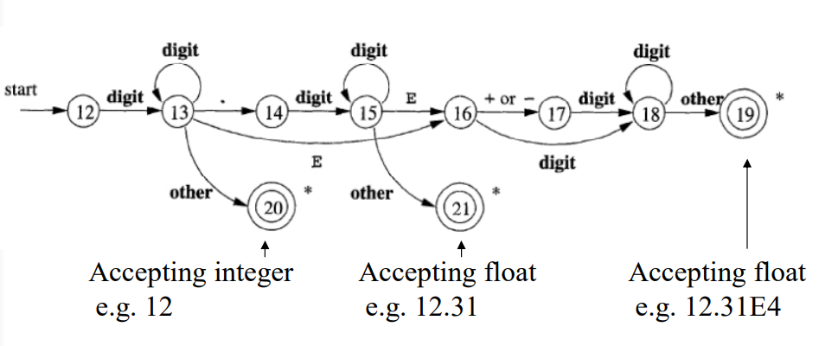
Another Example

Slide 13
Epsilon-Closures
We have to define the ε-closure to define the extended transition function for the ε-NFA.
We “ε-closure” a state q by following all transitions out of q that are labeled ε.

Slide 14
Epsilon-Closures (cont’d)
Formal recursive definition of the set ECLOSE(q) for q:
State q is in ECLOSE(q) (including the state itself);
If p is in ECLOSE(q), then all states accessible from p through paths of ε’s are also in ECLOSE(q).

Slide 15
Epsilon-Closures (cont’d)
ε-closure for a set of states S:
ECLOSE(S) = ∪_{q∈S} ECLOSE(q)
Example:
ECLOSE(1) = {1, 2, 3, 4, 6}
ECLOSE({3, 5}) = ECLOSE(3)∪ECLOSE(5) = {3, 6}∪{5, 7} = {3, 5, 6, 7}
ε
ε
ε
2
3
6
1
b
ε
4
7
5
ε
a

Slide 16
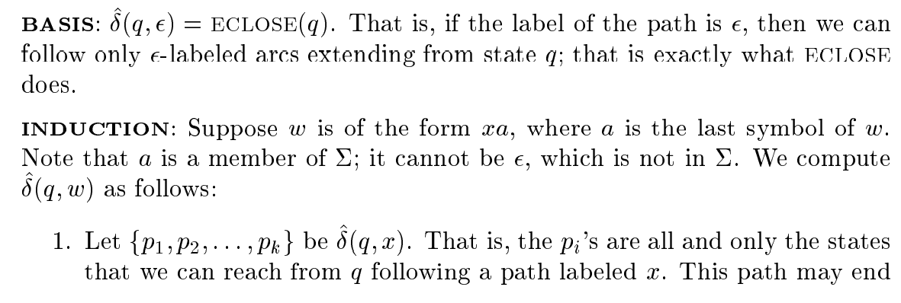
Extended Transition Function for an ε-NFA

Slide 17
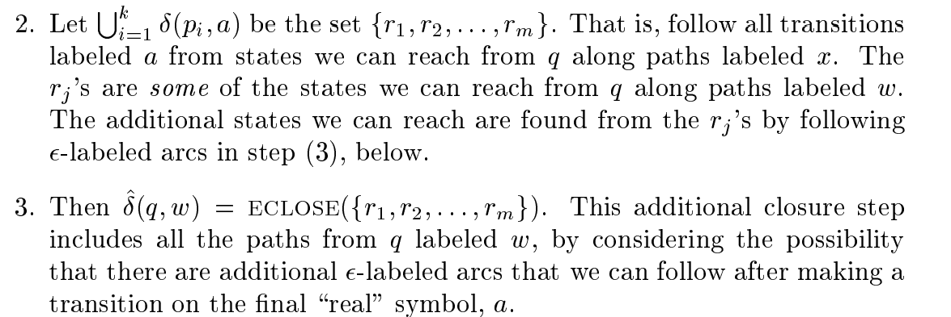
Extended Transition Function for an ε-NFA (cont’d)

Slide 18





Extended Transition Function for an ε-NFA (cont’d)
Example:

Slide 19
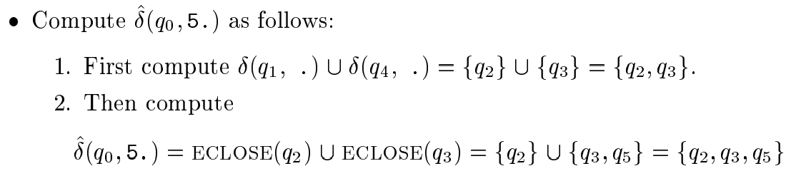
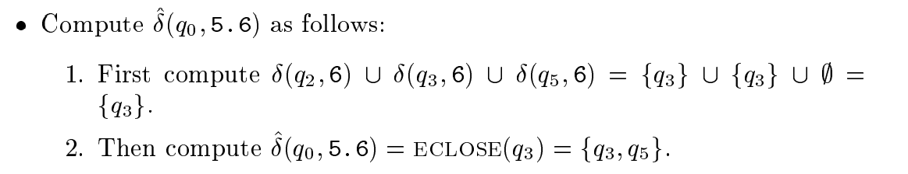
Extended Transition Function for an ε-NFA (cont’d)

Slide 20

Language for an ε-NFA
Formally, if E=(Q, Σ, δ, q₀, F) is an ε-NFA, then
$$L\left(E\right)=\{w|\hat{δ}(q_{0},w)∩F≠∅\}$$

Slide 21
Eliminating ε-Transitions
The ε-transition is good for design of FA, but for implementation, they have to be eliminated.
Given an ε-NFA, we can find an equivalent DFA (a theorem seen later).
Let E = (Q_{E}, Σ, δ_{E}, q₀, F_{E}) be the given ε-NFA, the equivalent DFA D = (Q_{D}, Σ, δ_{D}, q_{D}, F_{D}) is constructed as follows (in the next page).

Slide 22
Eliminating e-Transitions (cont’d)
Example:
Start state q_{D} = ECLOSE(q₀) = {q₀, q₁}
δ_{D}({q₀, q₁}, +) = ECLOSE(δ_{E}(q₀, +)∪δ_{E}(q₁, +))
= ECLOSE({q₁}∪φ) = ECLOSE({q₁}) = {q₁}, ...
δ_{D}({q₀, q₁}, 0) = ECLOSE(δ_{E}(q₀, 0)∪δ_{E}(q₁, 0))
= ECLOSE (φ∪{q₁, q₄}) = ECLOSE({q₁, q₄}) = {q₁, q₄}, ...
δ_{D}({q₀, q₁}, .) = ECLOSE(δ_{E}(q₀, .)∪δ_{E}(q₁, .)) = {q₂}
0, 1, …, 9
0, 1, …, 9
.
ε, + , -
0, 1, …, 9
q₃
ε
start
q₀
q₁
q₂
q₅
0, 1, …, 9
.
q₄

Slide 23
Eliminating e-Transitions (cont’d)
0, 1, …, 9
{q₁, q₄}
+ , -
start
{q₀, q₁}
{q₁}
.
{q₂}
Figure 2.22

Slide 24
Eliminating e-Transitions (cont’d)
Example: (cont’d)
δ_{D}({q₁}, 0) = ECLOSE(δ_{E}(q₁, 0)) = ECLOSE({q₁, q₄})
= {q₁, q₄}...
δ_{D}({q₁}, .) = ECLOSE(δ_{E}(q₁, .)) = ECLOSE({q₂})
= {q₂}
0, 1, …, 9
0, 1, …, 9
.
ε, + , -
0, 1, …, 9
q₃
ε
start
q₀
q₁
q₂
q₅
0, 1, …, 9
.
q₄

Slide 25
Eliminating e-Transitions (cont’d)
0, 1, …, 9
{q₁, q₄}
+ , -
0, 1, …, 9
start
{q₀, q₁}
{q₁}
.
.
{q₂}

Slide 26
Eliminating e-Transitions (cont’d)
Example: (cont’d)
δ_{D}({q₁, q₄}, 0) = ECLOSE(δ_{E}(q₁, 0)∪δ_{E}(q₄, 0))
= ECLOSE({q₁, q₄}∪φ) = {q₁, q₄}...
δ_{D}({q₁, q₄}, .) = ECLOSE(δ_{E}(q₁, .)∪δ_{E}(q₄, .)) =
ECLOSE({q₂}∪{q₃}) = ECLOSE(q₂)∪ECLOSE (q₃)
= {q₂}∪{q₃, q₅} = {q₂, q₃, q₅}
0, 1, …, 9
0, 1, …, 9
.
ε, + , -
0, 1, …, 9
q₃
ε
start
q₀
q₁
q₂
q₅
0, 1, …, 9
.
q₄
Figure 2.18

Slide 27
Eliminating e-Transitions (cont’d)
0, 1, …, 9
.
0, 1, …, 9
{q₁, q₄}
{q₂, q₃, q₅}
+ , -
0, 1, …, 9
start
{q₀, q₁}
{q₁}
.
.
{q₂}

Slide 28
Eliminating e-Transitions (cont’d)
Example: (cont’d)
δ_{D}({q₂}, 0) = ECLOSE(δ_{E}(q₂, 0)) = ECLOSE({q₃}) = {q₃, q₅} …
δ_{D}({q₂, q₃, q₅}, 0) = ECLOSE(δ_{E}(q₂, 0)∪δ_{E}(q₃, 0)∪
δ_{E}(q₅, 0))=ECLOSE({q₃}∪{q₃}∪φ)=ECLOSE(q₃)={q₃, q₅} …
0, 1, …, 9
0, 1, …, 9
.
ε, + , -
0, 1, …, 9
q₃
ε
start
q₀
q₁
q₂
q₅
0, 1, …, 9
.
q₄
Figure 2.18

Slide 29
Eliminating e-Transitions (cont’d)
0, 1, …, 9
.
0, 1, …, 9
{q₁, q₄}
{q₂, q₃, q₅}
+ , -
0, 1, …, 9
start
{q₀, q₁}
{q₁}
.
0, 1, …9
.
{q₂}
0, 1, …9
{q₃, q₅}

Slide 30
Eliminating e-Transitions (cont’d)
Example : (cont’d)
δ_{D}({q₃, q₅}, 0) = ECLOSE(δ_{E}(q₃, 0)∪δ_{E}(q₅, 0)) =ECLOSE({q₃}∪φ) =ECLOSE(q₃)={q₃, q₅} …
0, 1, …, 9
0, 1, …, 9
.
ε, + , -
0, 1, …, 9
q₃
ε
start
q₀
q₁
q₂
q₅
0, 1, …, 9
.
q₄
Figure 2.18

Slide 31
Eliminating e-Transitions (cont’d)
0, 1, …, 9
.
0, 1, …, 9
{q₁, q₄}
{q₂, q₃, q₅}
+ , -
0, 1, …, 9
start
{q₀, q₁}
{q₁}
.
0, 1, …9
.
{q₂}
0, 1, …9
{q₃, q₅}
0, 1, …, 9

Slide 32
Eliminating e-Transitions (cont’d)
0, 1, …, 9
Example: (cont’d)
The dead state φ need be shown.
But according to Section 2.3.7a, the diagram in the last page may be regarded as deterministic.
.
0, 1, …, 9
{q₁, q₄}
{q₂, q₃, q₅}
+ , -
0, 1, …, 9
+, -
{q₀, q₁}
{q₁}
+, -, .
start
.
0, 1, …9
+, -
φ
.
+, -, .
+, -, .
{q₂}
all symbols
{q₃, q₅}
0, 1, …, 9
0, 1, …, 9

Slide 33
SELF STUDY!!
Theorem 2.22
A language L accepted by some ε-NFA if and only if L is accepted by some DFA.
Proof: see the textbook yourself.

Slide 34
? Questions

